Slide 1
Ataraxia
Lo-fi Prototyping

Slide 2
Value Proposition
Interface
Prototyping

Slide 3
Value Proposition
Interface
Prototyping

Slide 4
Learn to be a happier you.

Slide 5
Value Proposition
Interface
Prototyping

Slide 6
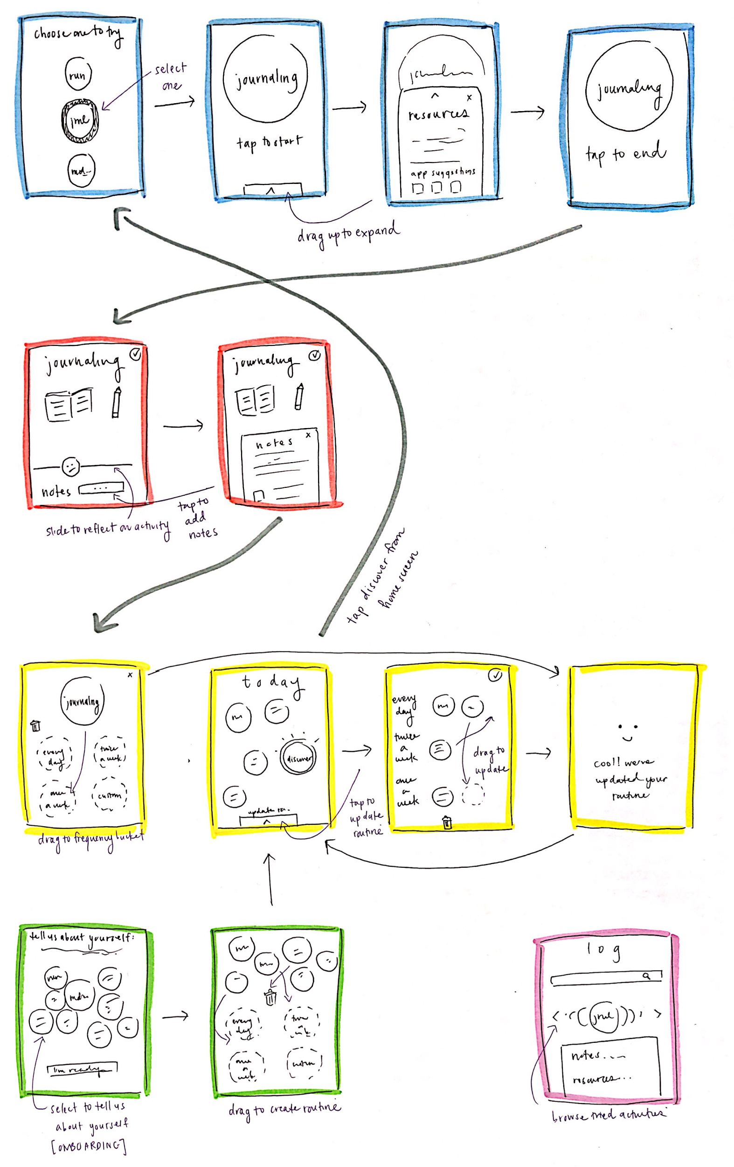
Selected Interface
Consistent, circular theme and design
Use of graphics = fun and visual experience
Lots of drag and dropping = less input text & complicated tasks

Slide 7
Value Proposition
Interface
Prototyping

Slide 8
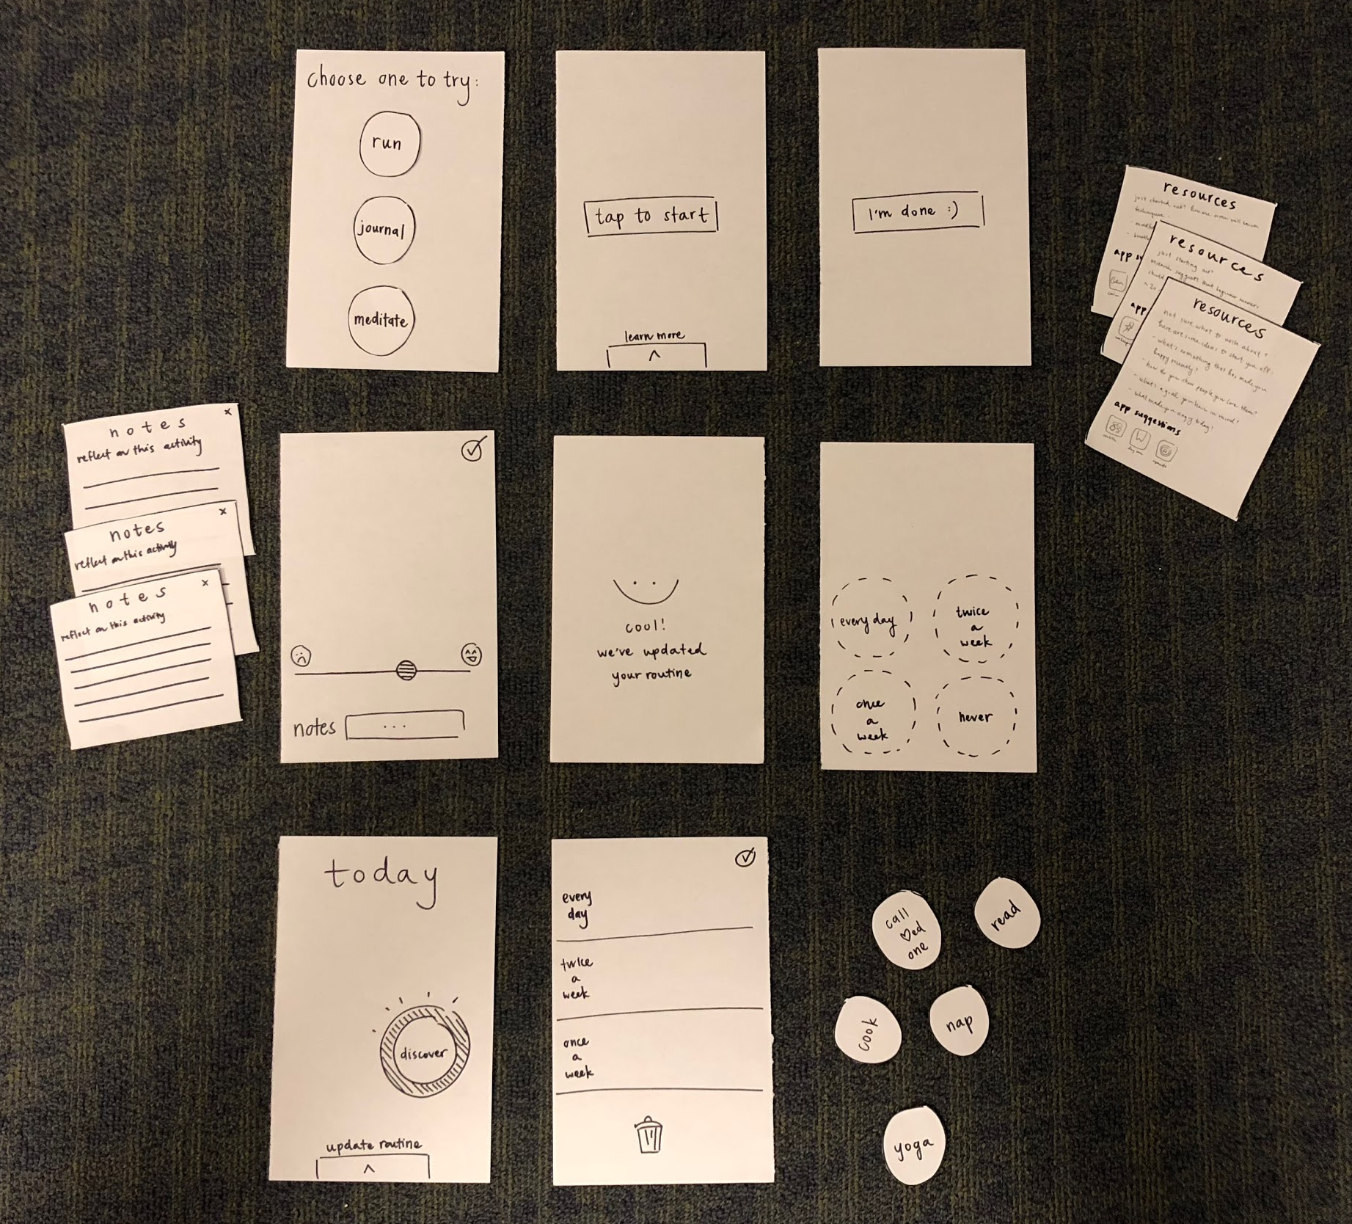
Lo-fi Prototype

Slide 9
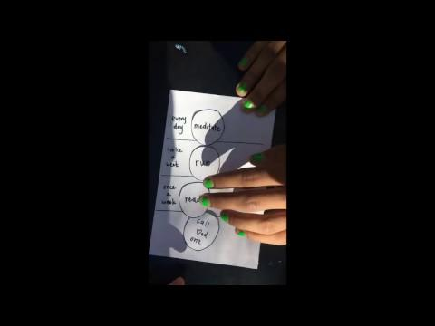

Slide 10
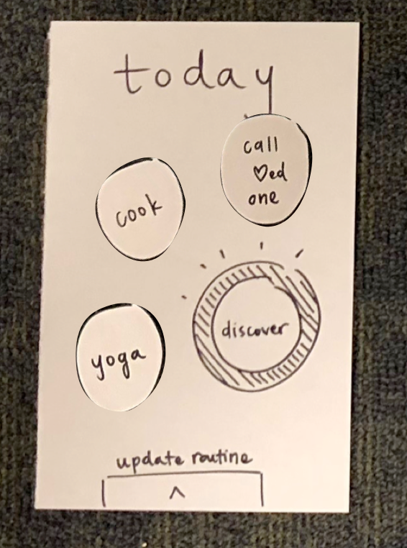
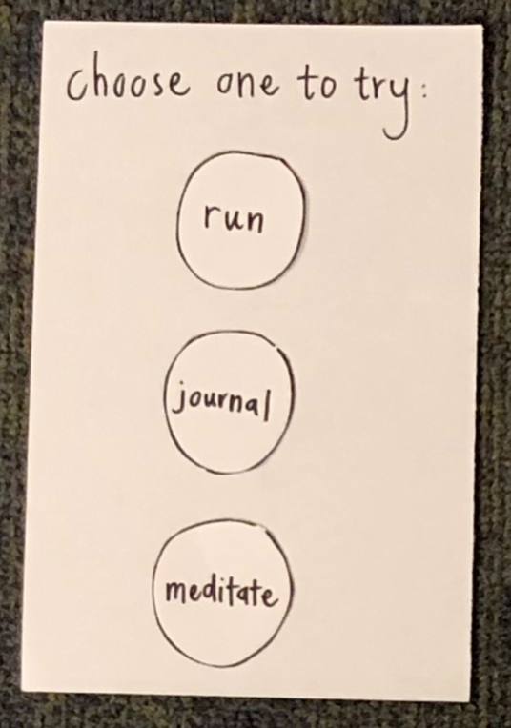
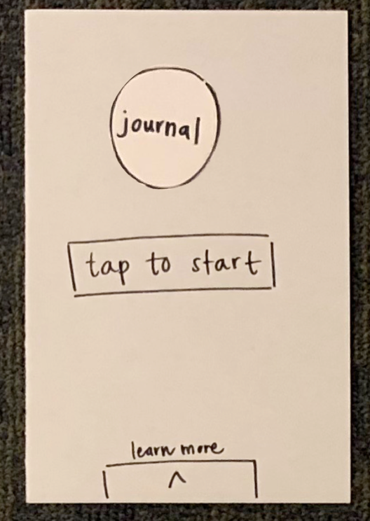
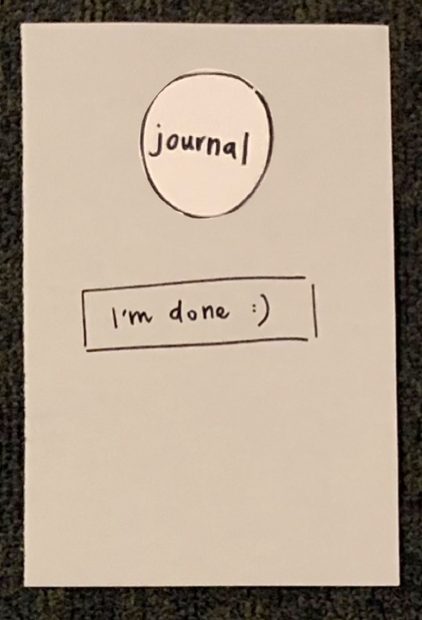
Task 1: Discover
Discover a new self-care method

Slide 11
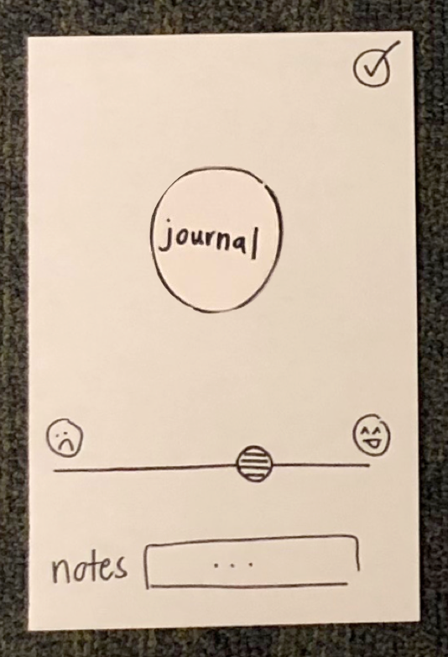
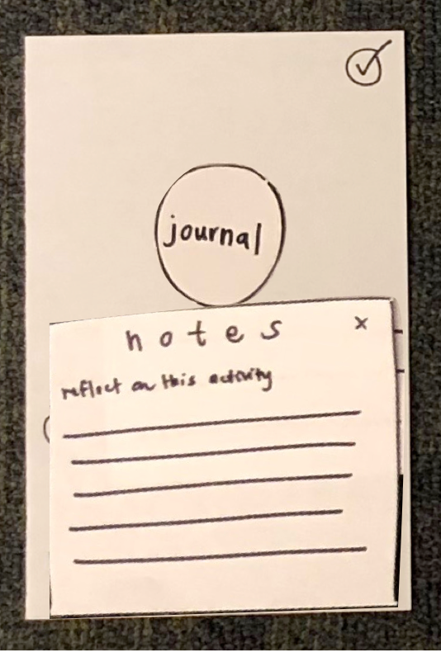
Task 2: Reflect
Record how a method of self-care makes you feel

Slide 12
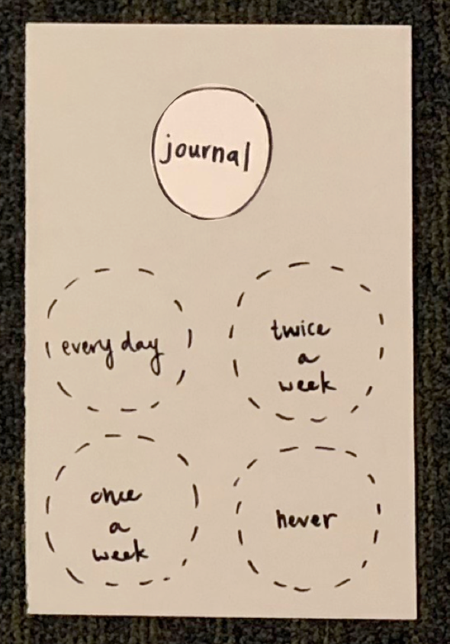
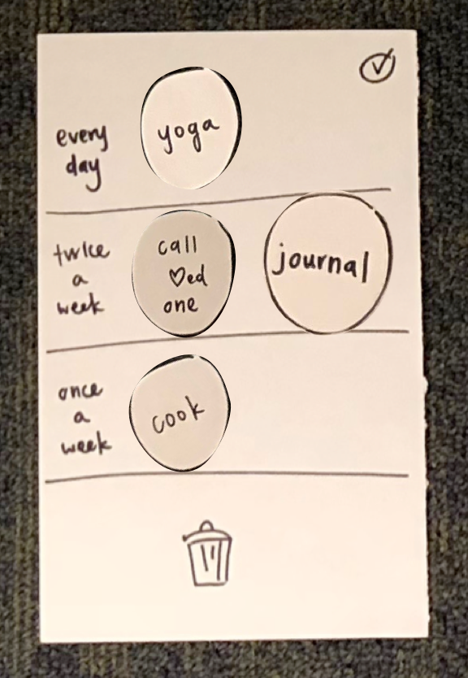
Task 3: Curate
Construct a self-care routine

Slide 13



Methods
Participant 1: Pastry Shop Employee
Tresidder Farmer’s market
Late 20’s
Participant 2: University Employee
Old Union
Late 30’s
Participant 3: Stanford Freshman, MS&E
Old Union
Late teen’s

Slide 14
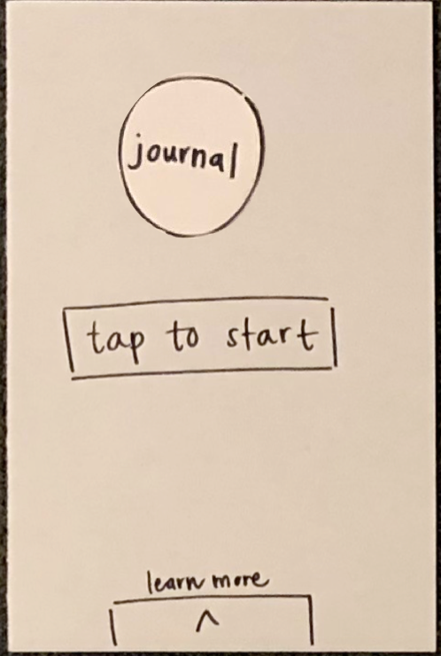
Task 1
*Swipes up to learn more* “I’d want to learn more about what I’m about to do”
“When I click meditate, would there be something telling me how to meditate? Or would I just go on my own and meditate and then click that I’m done?”
“How would I go about meditating?”

Slide 15
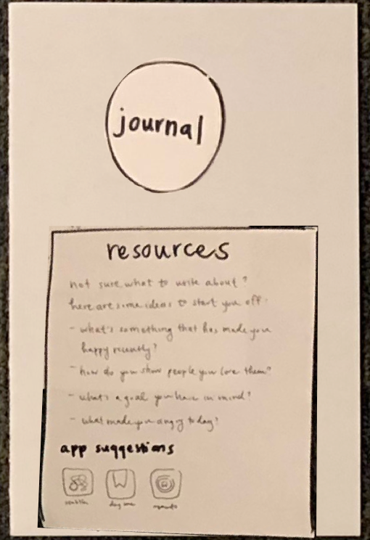
Task 1
“What are the app suggestions for?”
“Would you want these apps to work with your app in a specific way?”

Slide 16
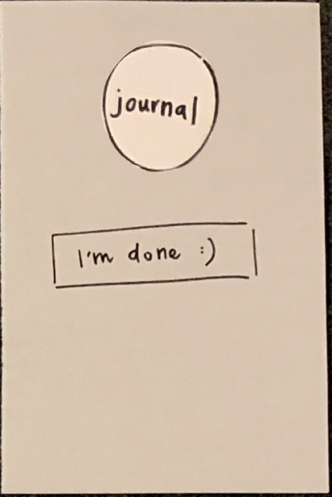
Task 1
“This is a little confusing, I got a screen that says I’m done but I haven’t meditated yet.”

Slide 17
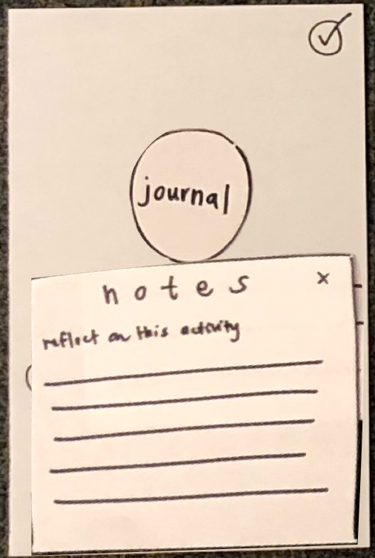
Task 2
“I would add notes”
“Would the notes stay there? So that next time I do it I could look back?”
“I didn’t see a save button”

Slide 18
Task 3
People really liked the schedule UI

Slide 19
Suggested UI Changes
Show tips and instructions for each activity, some people missed the ‘Learn More’ option
Change the ‘Tap to start’ and ‘I’m done’ screens to be more intuitive
Show statistics about why it’s healthy to incorporate each activity into your life

Slide 20
Summary
People liked the circles and drag & drop UI
Main issues:
Not enough direction on how to do the activities
The “I’m done” screen was confusing
Next steps:
Rethink how the user indicates that they’ve tried an activity
Make “Resources” tab more clear when selecting an activity

Slide 21
Questions?

